Slide 1

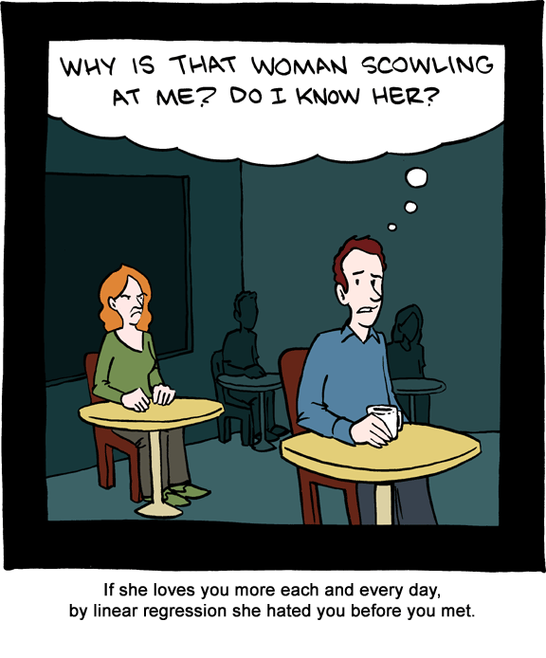
BMGT 431: Linear Regression Review
ANLY 6100: Data Analytics I Intro to/Review of Linear Regression
Fall 2020, Topic 1
Professor: Courtney Paulson
Fall 2018, Topic 1
Instructor: Courtney Paulson
Image description: A cartoon of a woman is scowling at a man. The man thinks to himself, “Why is that woman scowling at me? Do I know her? The caption of the cartoon reads, If she loves you more each and every day, by linear regression she hated you before you met.

Slide 2
Assignment 1
Up on Canvas; due Friday at 11:59 PM
Submit a Word or PDF file
Include R code
Yes, you may work with others; last question asks you to list anyone you worked with
Assignment 2 will be up on Friday as well, if you want to get started
First part: writing a function in R to play a game
Second part: brief introduction to running a regression in R

Slide 3
Today
This Topic:
Introduction to (supervised) predictive modeling and statistical learning
Review of linear regression
Evaluating models
Linear regression in R

Slide 4
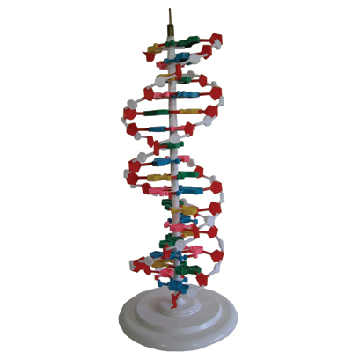
What is a model?
A simplified representation of reality created for a specific purpose
“All models are wrong but some are useful” –George Box
Examples of models: map, prototype, regression!
Image description: A standing representation of a DNA molecule

Slide 5
Terminology
Model | A simplified representation of reality created to serve a purpose
Instance/Example/Observation | Represents one fact or data point
Attributes/Features/Predictors | A set of values that describe an observation (the independent variables)
Target Variable/Response | The unknown value of interest (the dependent variable)
Predictive Model | A formula for estimating the response variable
Prediction | An estimate of the target variable

Slide 6
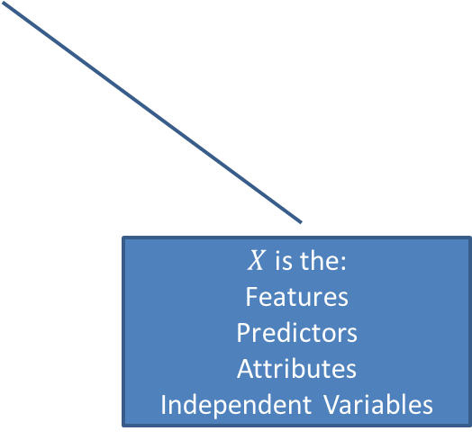
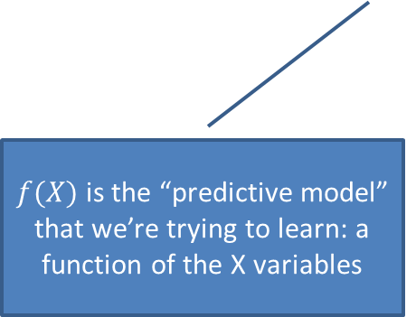
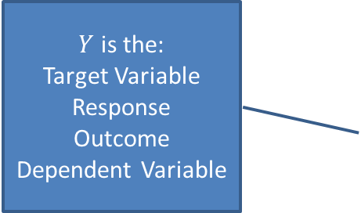

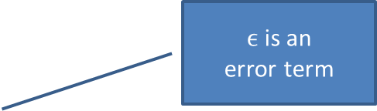
What is Statistical Learning?
$Y$ is the:
Target Variable
Response
Outcome
Dependent Variable
$ϵ$ is an
error term
$$Y=f\left(X\right)+ε$$
$f(X)$is the “predictive model” that we’re trying to learn: a function of the X variables
$X$ is the:
Features
Predictors
Attributes
Independent Variables
Notes:
Statistical learning is all about learning f
Important concepts:
How do we estimate f?
What is the space that we search over to find f?
What is the purpose of learning f: prediction or inference?
How do we know if our model is any good?

Slide 7
Why are we estimating f?
Prediction: we know the input features X, but we don’t know Y and would like to estimate it
Will person A suspend their Facebook account in the next month?
Is this picture a cat or a dog?
Does this review indicate a positive or negative opinion of the movie?
What will sales be in the next 4 weeks?
Is this account fraudulent?
Inference: how is Y affected when X changes?
If I give person A an incentive to stay on Facebook, will they do so?
Which facial features distinguish cats from dogs?
What is the relationship between review sentiment and the words in the reviews?
How much do advertising budgets affect sales?
Image description: A picture of a cat vs. a picture of a dog

Slide 8
Fundamental Question: What kind of relationship? (What is f?)
We assume a relationship exists
Linear Regression: is the relationship a straight line?
Exact linear relationship
Costs
Total Cost = Fixed Cost + Variable Cost*Variable
Example:
Tuition = Fees + Cost Per Credit Hour*Number of Credit Hours
Data
No
No
Model Specification
Parameter Estimation
Model Adequacy
Yes
Model Validation
Yes
Model Use
Theory

Slide 9
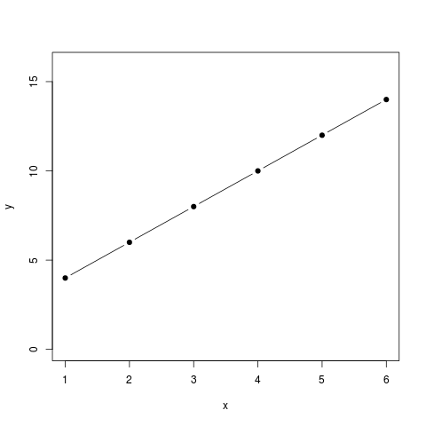
Example of Exact Linear Relationship
Variable cost; as X increases by 1, how does Y increase?
Fixed cost; no matter what X is, this cost occurs
0
2
4

Slide 10
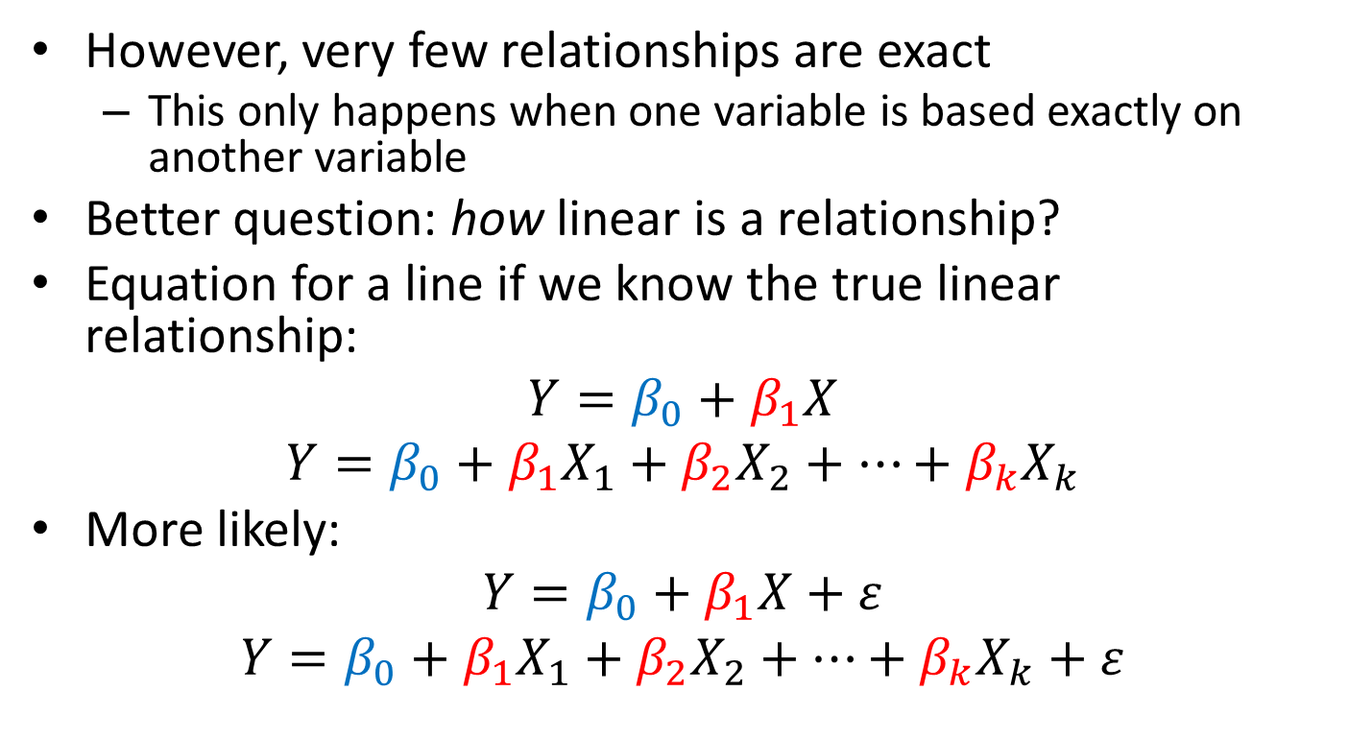
Fundamental Question: What kind of relationship?
However, very few relationships are exact
This only happens when one variable is based exactly on another variable
Better question: how linear is a relationship?
Equation for a line if we know the true linear relationship:
$$Y=β_{0}+β_{1}X$$
$$Y=β_{0}+β_{1}X_{1}+β_{2}X_{2}+…+β_{k}X_{k}$$
More likely:
$$Y=β_{0}+β_{1}X+ε$$
$$Y=β_{0}+β_{1}X_{1}+β_{2}X_{2}+…+β_{k}X_{k}+ε$$

Slide 11
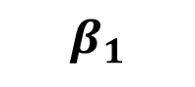
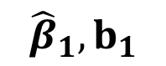
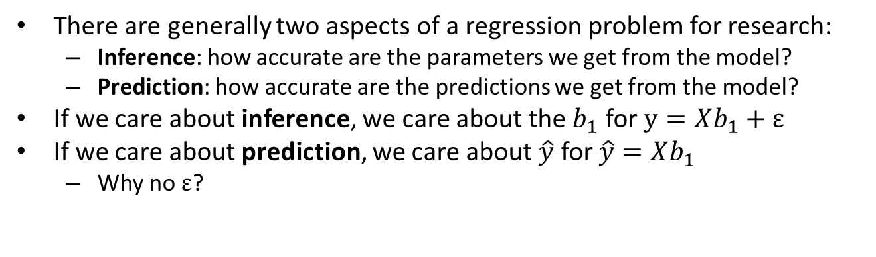
Fundamental Research Question: Prediction or Inference?
Statistics estimate
parameters
$$β_{1}$$
Population
Sample
$${\hat{β}}_{1}, b_{1}$$
(Parameters)
Statistics
Select a
random sample
(size n)
There are generally two aspects of a regression problem for research:
Inference: how accurate are the parameters we get from the model?
Prediction: how accurate are the predictions we get from the model?
If we care about inference, we care about the $b_{1}$ for $y=Xb_{1}+ε$
If we care about prediction, we care about $\hat{y}$ for $\hat{y}=Xb_{1}$
Why no $ε$?

Slide 12
Question to Consider
You are testing to see if there is a relationship between having a college degree and the likelihood of voting in the next election. You take a sample of registered voters and find 75% of those with a college degree plan to vote in the next election. What is the value of the sample statistic for this problem?
0%
50%
75%
100%
Unknown

Slide 13
Question to Consider
You are testing to see if there is a relationship between having a college degree and the likelihood of voting in the next election. You take a sample of registered voters and find 75% of those with a college degree plan to vote in the next election. What is the value of the population parameter for this problem?
0%
50%
75%
100%
Unknown

Slide 14
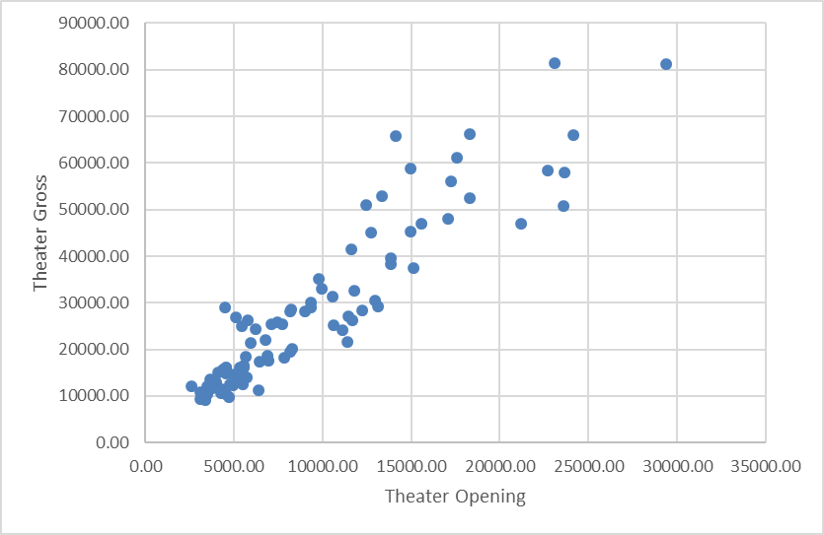
First question: is linear relationship appropriate?
Scatterplot of top 100-grossing movies (domestically) of 2014, Total Gross vs. Opening Weekend (both in dollars per theater)
Scatterplot description: A general trend where as the amount a movie makes per theater on opening weekend (x-axis) increases, so does the amount a movie makes gross overall per theater (y-axis)

Slide 15
Next question: what’s the best line?
Scatterplot of top 100-grossing movies (domestically) of 2014, Total Gross vs. Opening Weekend
Scatterplot description: A general trend where as the amount a movie makes per theater on opening weekend (x-axis) increases, so does the amount a movie makes gross overall per theater (y-axis)

Slide 16
Next question: what’s the best line?
Note: points do not lie on line
So, how do we choose this line?
Scatterplot description: A general trend where as the amount a movie makes per theater on opening weekend (x-axis) increases, so does the amount a movie makes gross overall per theater (y-axis). A best-fit line has been added through the points.

Slide 17
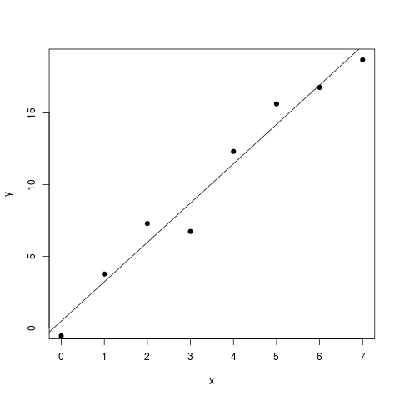
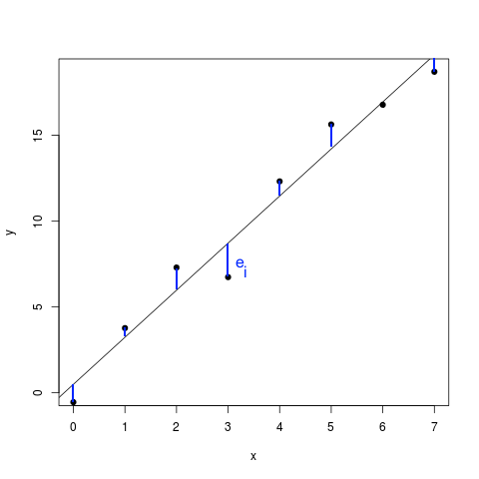
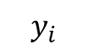
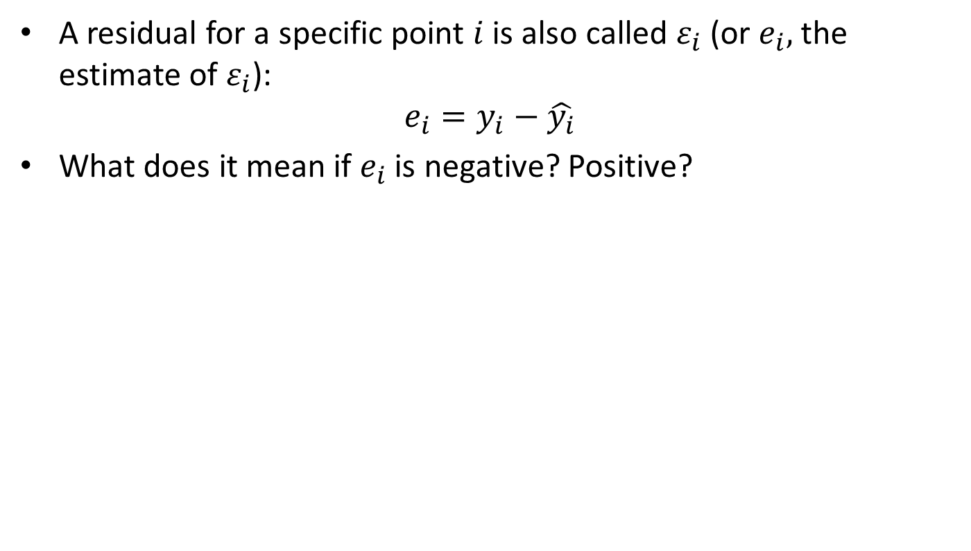
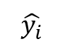
Next question: what’s the best line?
A residual for a specific point $i$ is also called $ε_{i}$ (or $e_{i},$ the estimate of $ε_{i}$):
$$e_{i}=y_{i}−\hat{y_{i}}$$
What does it mean if $e_{i}$ is negative? Positive?
$$\hat{y_{i}}$$
$$y_{i}$$
A picture of a scatterplot with points above and below a trend line
A picture of a scatterplot with points above and below a trend line, with lines drawn from the point to the trend line to illustrate the error in the prediction
Notes:
If e is negative: the prediction is above the actual value (the point is below the line). If e is positive, point is above the line (prediction is less than actual).

Slide 18
Next question: what’s the best line?
Because errors have a lot of extremely helpful statistical properties, residual analysis is a major research area
So, can we just minimize errors, then?
Compare errors here:
To errors here:
A picture of a scatterplot with a trend line completely to the left of all data points
A picture of a scatterplot with a trend line going straight through all data points
Notes:
No; we have to minimize squared errors

Slide 19
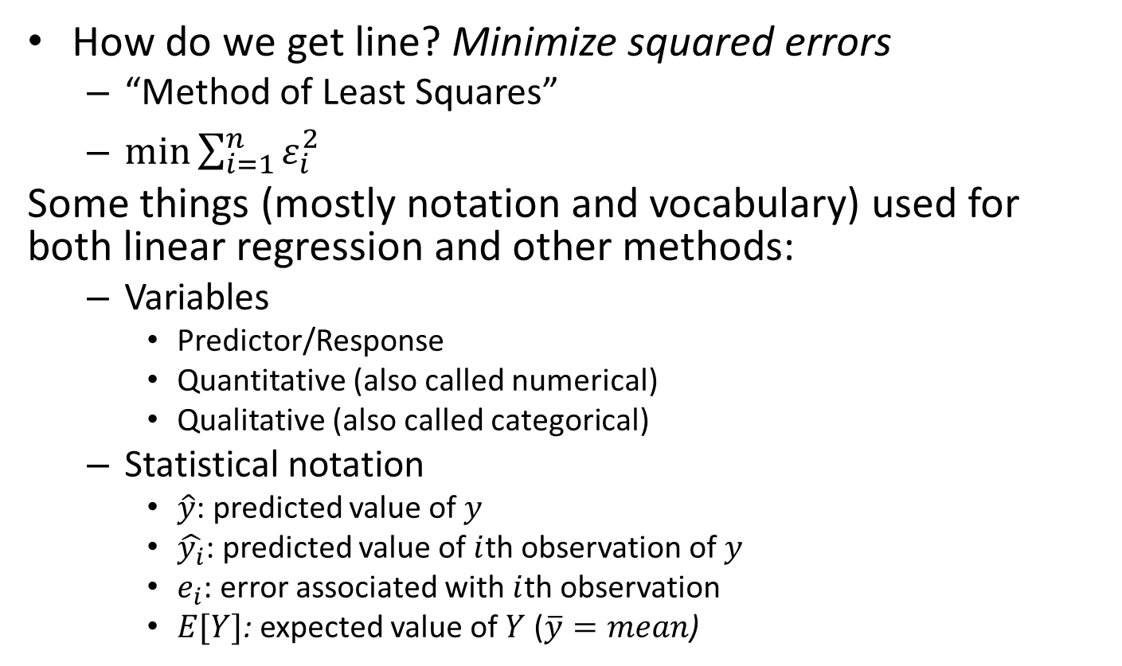
Linear Regression
How do we get line? Minimize squared errors
“Method of Least Squares”
$\min{\sum_{i=1}^{n}{ε_{i}^{2}}}$
Some things (mostly notation and vocabulary) used for both linear regression and other methods:
Variables
Predictor/Response
Quantitative (also called numerical)
Qualitative (also called categorical)
Statistical notation
$\hat{y}$: predicted value of $y$
$\hat{y_{i}}$: predicted value of $i$th observation of $y$
$e_{i}$: error associated with $i$th observation
$E[Y]$: expected value of $Y$ ($\overline{y}=mean$)

Slide 20
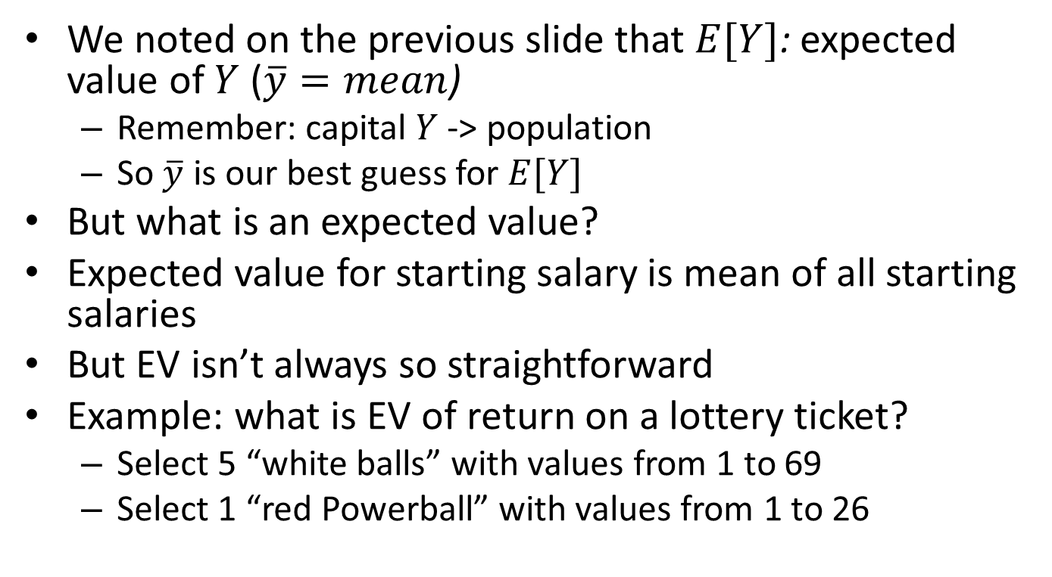
Expected Value
We noted on the previous slide that $E[Y]$: expected value of $Y$ ($\overline{y}=mean$)
Remember: capital $Y$ -> population
So $\overline{y}$ is our best guess for $E[Y]$
But what is an expected value?
Expected value for starting salary is mean of all starting salaries
But EV isn’t always so straightforward
Example: what is EV of return on a lottery ticket?
Select 5 “white balls” with values from 1 to 69
Select 1 “red Powerball” with values from 1 to 26

Slide 21
Expected Value of a Powerball Ticket
Match | Prize | Odds
5 Numbers + PB | “Grand Prize” | 1 : 292,201,338.00
5 Numbers | $1,000,000 | 1 : 11,688,053.52
4 Numbers + PB | $50,000 | 1 : 913,129.18
4 Numbers | $100 | 1 : 36,525.17
3 Numbers + PB | $100 | 1 : 14,494.11
3 Numbers | $7 | 1 : 579.76
2 Numbers + PB | $7 | 1 : 701.33
2 Numbers | $4 | 1 : 91.98
PB | $4 | 1 : 38.32
= 0.0000003%
= 0.0000086%
= 0.0001095%
= 0.0027378%
= 0.0068989%
= 0.1721882%
= 0.1423832%
= 1.0755001%
= 2.5432350%
More information at https://spreadsheetsolving.com/expected-value-of-powerball-ticket
Powerball says the overall odds of winning a prize are 1 in 24.87. Does that seem right to you?

Slide 22
Expected Value of a Powerball Ticket
Match | Prize | Odds
5 Numbers + PB | “Grand Prize” | 1 : 292,201,338.00
5 Numbers | $1,000,000 | 1 : 11,688,053.52
4 Numbers + PB | $50,000 | 1 : 913,129.18
4 Numbers | $100 | 1 : 36,525.17
3 Numbers + PB | $100 | 1 : 14,494.11
3 Numbers | $7 | 1 : 579.76
2 Numbers + PB | $7 | 1 : 701.33
2 Numbers | $4 | 1 : 91.98
PB | $4 | 1 : 38.32
= 0.0000003%
= 0.0000086%
= 0.0001095%
= 0.0027378%
= 0.0068989%
= 0.1721882%
= 0.1423832%
= 1.0755001%
= 2.5432350%
More information at https://spreadsheetsolving.com/expected-value-of-powerball-ticket
How do we calculate the expected return (or EV) of a Powerball ticket?

Slide 23
Expected Value of a Powerball Ticket
Let’s calculate that out (assume “grand prize” of $20,000,000):
Match | Prize | Probability
5 Numbers + PB | $20,000,000 | 0.000000003
5 Numbers | $1,000,000 | 0.000000086
4 Numbers + PB | $50,000 | 0.000001095
4 Numbers | $100 | 0.000027378
3 Numbers + PB | $100 | 0.000068989
3 Numbers | $7 | 0.001721882
2 Numbers + PB | $7 | 0.001423832
2 Numbers | $4 | 0.010755001
PB | $4 | 0.025432350
= 20000000*0.000000003 = $0.07
= 1000000*0.000000086 = $0.09
= 50000*0.000001095 = $0.05
= 100*0.000027378 = $0.00
= 100*0.000068989 = $0.01
= 7*0.001721882 = $0.01
= 7*0.001423832 = $0.01
= 4*0.010755001 = $0.04
= 4*0.025432350 = $0.10
Add them all up to get total expected return: $0.39
….on a $2 ticket

Slide 24
So, should you play Powerball?
Is Powerball a worthwhile investment?
You should expect to lose $1.61 of your $2
That’s 80.50% of your money lost per ticket!
But that’s at $20,000,000
Powerball grows each time it isn’t won
How big would the jackpot have to be to give you a positive expected return?
$494,000,000…assuming you don’t split it!

Slide 25
Question to Consider
Your friend invites you to play the following game. She will roll a die. If the die lands on 1 or 2, you win $10. If the die lands on 3, you win $7. If the die lands on 4, you win $2. If the die lands on 5 or 6, you lose. If this game costs $5 to play, should you play? Explain your answer.

Slide 26
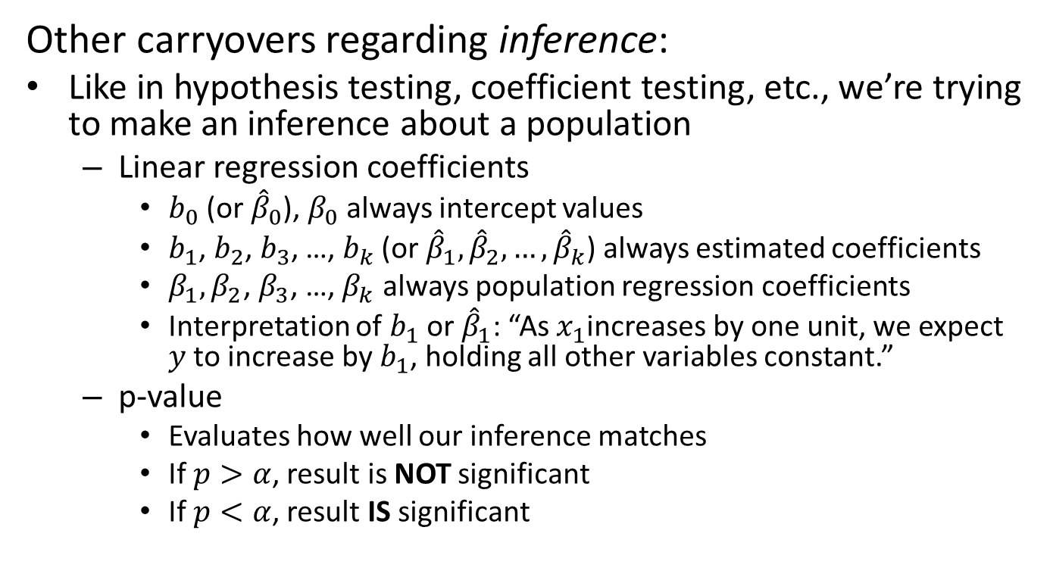
Important Carryovers from Linear Regression
Other carryovers regarding inference:
Like in hypothesis testing, coefficient testing, etc., we’re trying to make an inference about a population
Linear regression coefficients
$b_{0}$ (or ${\hat{β}}_{0}$), $β_{0}$ always intercept values
$b_{1}$, $b_{2}$, $b_{3}$, …, $b_{k}$ (or ${\hat{β}}_{1}, {\hat{β}}_{2},…,{\hat{β}}_{k}$) always estimated coefficients
$β_{1},β_{2}$, $β_{3}$, …, $β_{k}$ always population regression coefficients
Interpretation of $b_{1}$ or ${\hat{β}}_{1}$: “As $x_{1}$increases by one unit, we expect $y$ to increase by $b_{1}$, holding all other variables constant.”
p-value
Evaluates how well our inference matches
If $p>α$, result is NOT significant
If $p<α$, result IS significant

Slide 27
What is a p-value?
p-value: “What’s the probability the null hypothesis is true given this particular sample?”
“Null hypothesis” is a general term for any inference test
In linear regression (like other methods), two inference tests:
F-test:
Tests overall model fit
Null hypothesis: “This model is NOT useful”
Coefficient test(s):
Tests individual predictor (x) variables
Null hypothesis: “This predictor is NOT useful”
So if p = 0.01, there is a 1% chance we would get this result assuming the null hypothesis is true

Slide 28
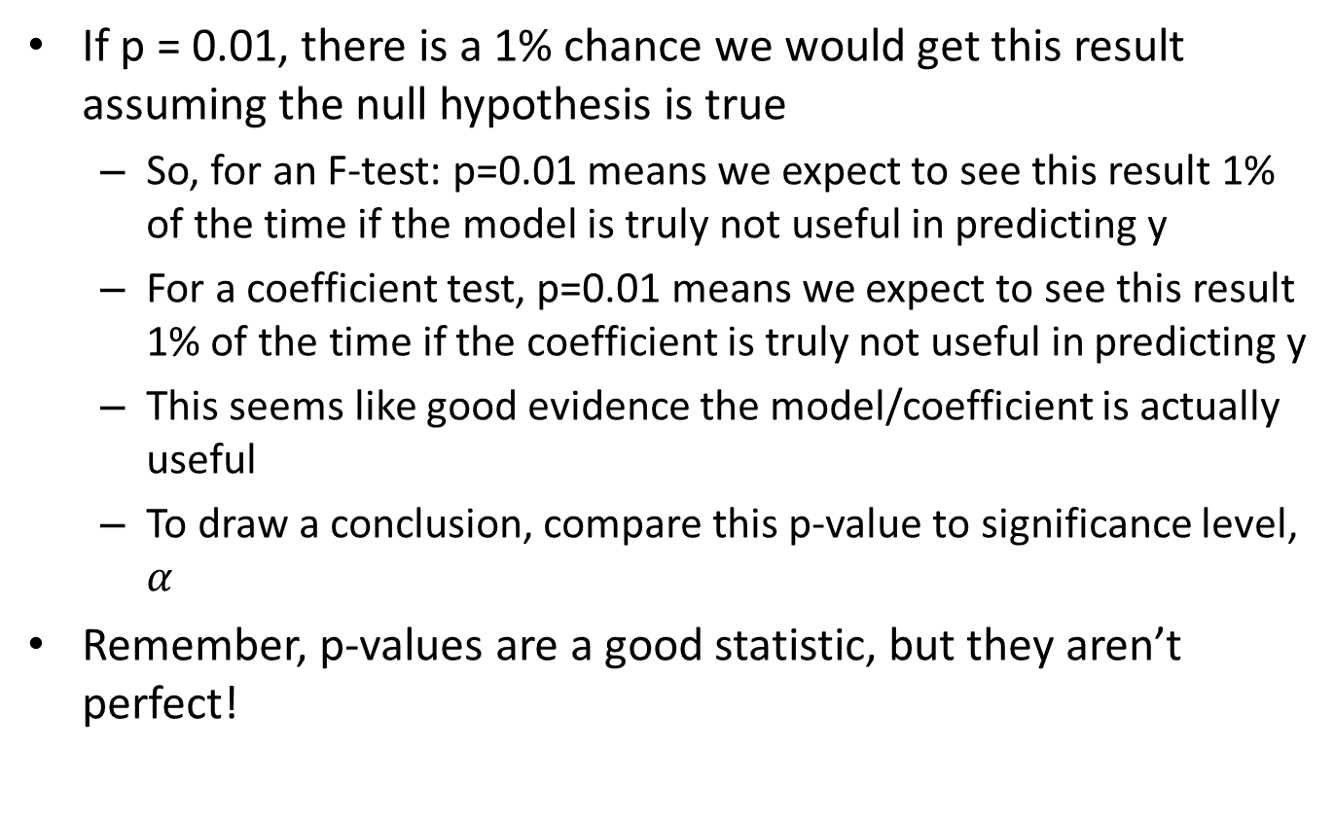
What is a p-value?
If p = 0.01, there is a 1% chance we would get this result assuming the null hypothesis is true
So, for an F-test: p=0.01 means we expect to see this result 1% of the time if the model is truly not useful in predicting y
For a coefficient test, p=0.01 means we expect to see this result 1% of the time if the coefficient is truly not useful in predicting y
This seems like good evidence the model/coefficient is actually useful
To draw a conclusion, compare this p-value to significance level, $α$
Remember, p-values are a good statistic, but they aren’t perfect!

Slide 29
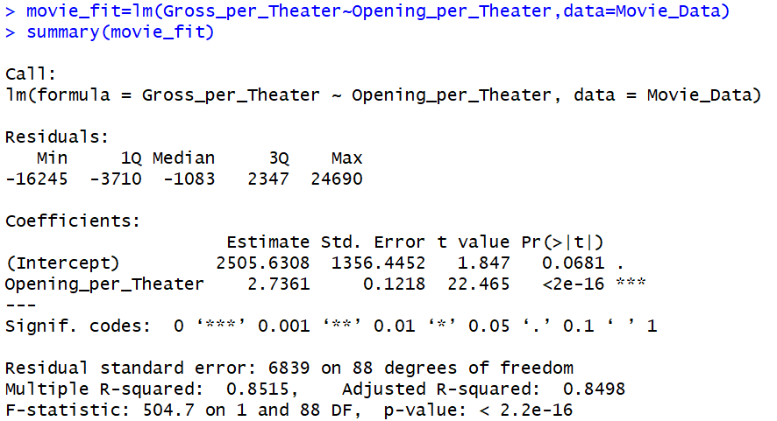
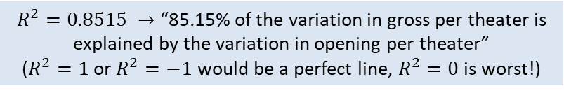
In R: summary() function output:
Values for equation of the line
Relationship between X and Y is significant
Model is useful (significant)
$R^{2}=0.8515 →$ “85.15% of the variation in gross per theater is explained by the variation in opening per theater”
($R^{2}=1$ or $R^{2}=−1$ would be a perfect line, $R^{2}=0$ is worst!)

Slide 30
What this looks like in R Output:
> Movie_Data <- read.csv("Movie_Data.csv")
> movie_fit <- lm(Gross_per_Theater~Opening_per_Theater, data = Movie_Data)
> summary(movie_fit)
Call:
lm(formula = Gross_per_Theater ~ Opening_per_Theater, data = Movie_Data)
Residuals:
Min 1Q Median 3Q Max
-16245 -3710 -1083 2347 24690
Coefficients:
Estimate Std. Error t value Pr(>|t|)
(Intercept) 2505.6308 1356.4452 1.847 0.0681 .
Opening_per_Theater 2.7361 0.1218 22.465 <2e-16 ***
---
Signif. codes: 0 ‘***’ 0.001 ‘**’ 0.01 ‘*’ 0.05 ‘.’ 0.1 ‘ ’ 1
Residual standard error: 6839 on 88 degrees of freedom
Multiple R-squared: 0.8515, Adjusted R-squared: 0.8498
F-statistic: 504.7 on 1 and 88 DF, p-value: < 2.2e-16

Slide 31
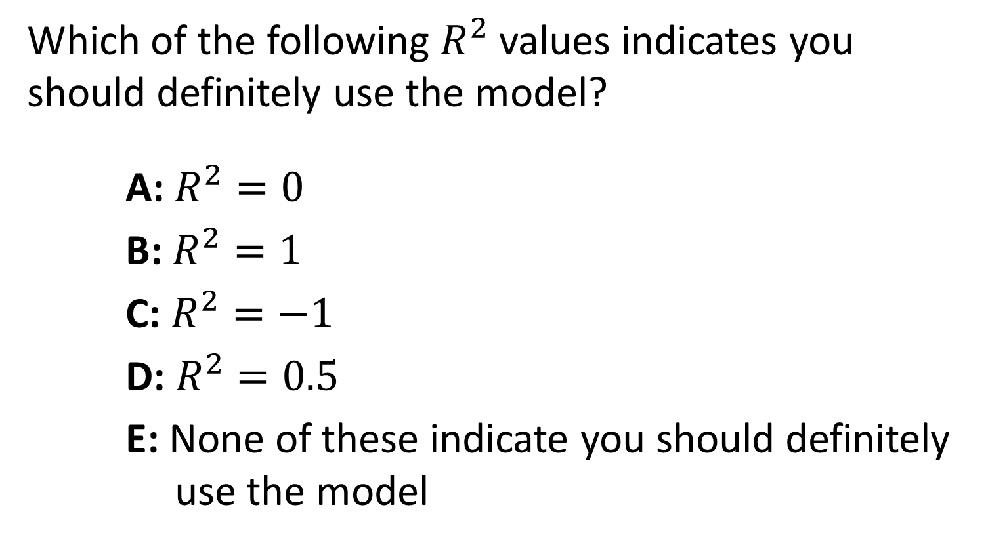
Question to Consider
Which of the following $R^{2}$ values indicates you should definitely use the model?
A: $R^{2}=0$
B: $R^{2}=1$
C: $R^{2}=−1$
D: $R^{2}=0.5$
E: None of these indicate you should definitely use the model

Slide 32
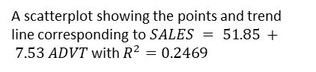
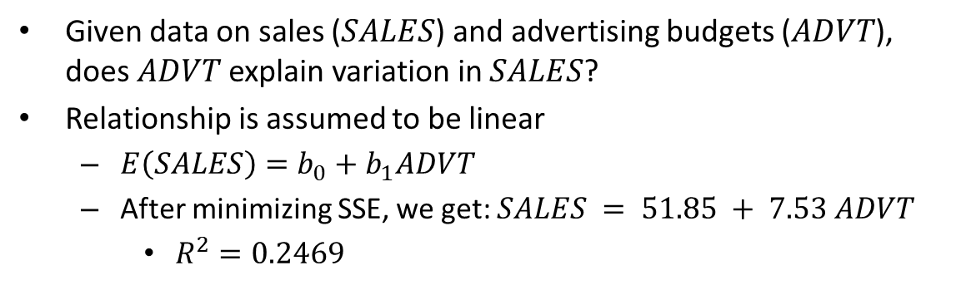
Simple Linear Regression
Given data on sales ($SALES$) and advertising budgets ($ADVT$), does $ADVT$ explain variation in $SALES$?
Relationship is assumed to be linear
$E\left(SALES\right)=b_{0}+b_{1}ADVT$
After minimizing SSE, we get: $SALES = 51.85 + 7.53 ADVT$
$R^{2}=0.2469$
A scatterplot showing the points and trend line corresponding to $SALES = 51.85 + 7.53 ADVT$ with $R^{2}=0.2469$

Slide 33
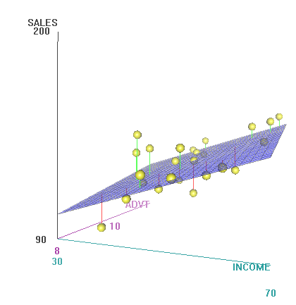
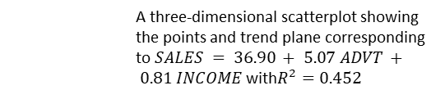
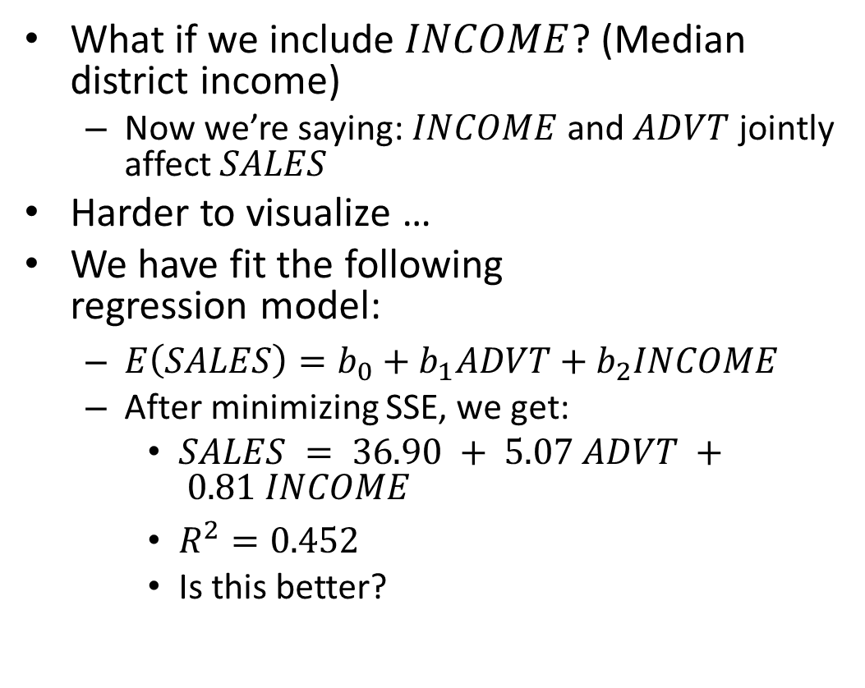
Multiple Linear Regression
What if we include $INCOME$? (Median district income)
Now we’re saying: $INCOME$ and $ADVT$ jointly affect $SALES$
Harder to visualize …
We have fit the following regression model:
$E\left(SALES\right)=b_{0}+b_{1}ADVT+b_{2}INCOME$
After minimizing SSE, we get:
$SALES = 36.90 + 5.07 ADVT + 0.81 INCOME$
$R^{2}=0.452$
Is this better?
A three-dimensional scatterplot showing the points and trend plane corresponding to $SALES = 36.90 + 5.07 ADVT + 0.81 INCOME$with$R^{2}=0.452$
Notes:
We can’t tell if it’s better; R squared doesn’t give us the whole picture

Slide 34
Prediction
Multiple linear regression (MLR) is harder to visualize, but the concepts hold
MLR is much more common for making predictions
Use the regression equation to predict what the response (dependent variable) will be for particular values of the predictors (independent variables)
E.g. What will SALES be if ADVT is $10,000?
Often interested in making predictions about the future
What will Sales revenues be next year?
The data might consist of past Sales numbers, and we could be interested in the trend
Can use time as a predictor

Slide 35
US Retail Sales
Data: US Retail Sales (Jan-1992 to Oct-2014)
Variables:
Value of retail sales (in $ millions)
Time, Month, Time² and Time³ are created variables
Period | Value | Time | Month | Time^2 | Time^3
Jan 1992 | 146,376 | 1 | 1 | 1 | 1
Feb 1992 | 147,079 | 2 | 2 | 4 | 8
Mar 1992 | 159,336 | 3 | 3 | 9 | 27
Apr 1992 | 163,669 | 4 | 4 | 16 | 64
May 1992 | 170,068 | 5 | 5 | 25 | 125
Jun 1992 | 168,663 | 6 | 6 | 36 | 216
Jul 1992 | 169,890 | 7 | 7 | 49 | 343
Aug 1992 | 170,364 | 8 | 8 | 64 | 512
Sep 1992 | 164,617 | 9 | 9 | 81 | 729

Slide 36
Predicting Retail Sales
We want to find a model that predicts retail sales well
Many potential choices for models (even with only one variable over time)
Linear trend
Seasonal adjustments
Nonlinear trends
How do we determine if a model performs well?
Need to establish a performance criterion

Slide 37
Data Partitioning
To judge predictive performance we want to evaluate how a model does with unseen data
We split the sample
Training data set – used to estimate model parameters
For sales data, first 164 observations
Testing data set – used to measure errors in prediction
For sales data, most recent 110 observations
A variety of measures of errors in prediction are used. We will focus on:
Root Mean Squared Error (RMSE)
Average error

Slide 38
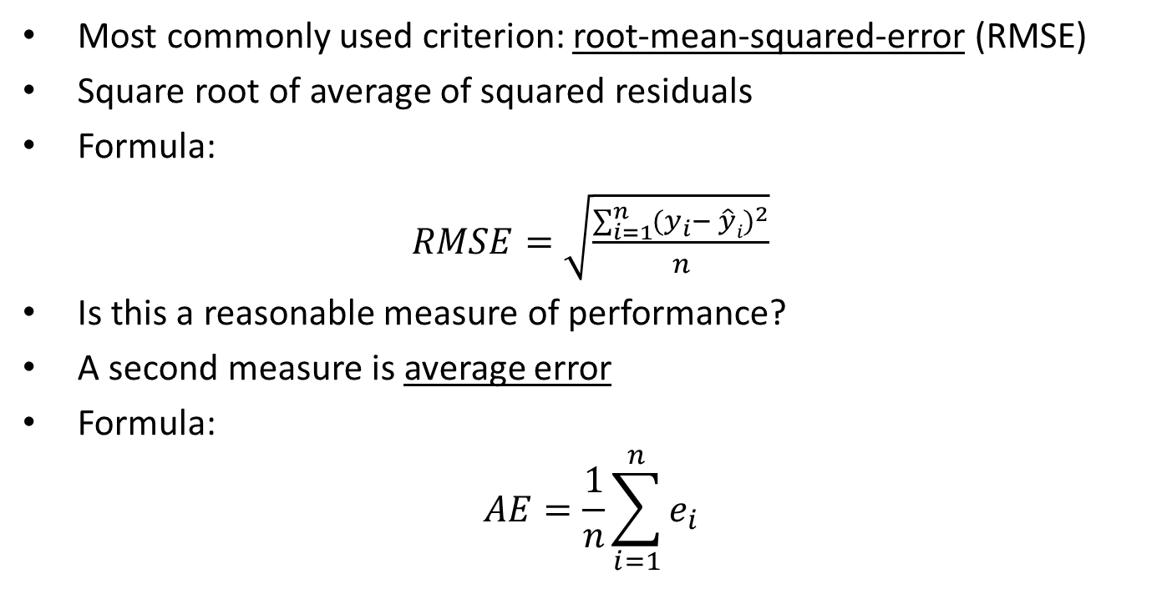
Evaluating Predictive Performance
Most commonly used criterion: root-mean-squared-error (RMSE)
Square root of average of squared residuals
Formula:
$RMSE=\sqrt{\frac{\sum_{i=1}^{n}{(y_{i}{− \hat{y}i)}^{2}}}{n}}$
Is this a reasonable measure of performance?
A second measure is average error
Formula:
$$AE=\frac{1}{n}\sum_{i=1}^{n}{e_{i}}$$

Slide 39
Evaluating Predictive Performance
Important Point!
These are to be computed on test data set
Why not the training data?
Notes:
The model is built with training data. We need to know how the model performs on data it hasn’t used (what if we want to predict future data points, for example?)

Slide 40
Linear trend model
summary(fit1)
Call:
lm(formula = Value ~ T, data = Train)
Residuals:
Min 1Q Median 3Q Max
-42818 -6977 969 6640 61824
Coefficients:
Estimate Std. Error t value Pr(>|t|)
(Intercept) 158495.47 2856.30 55.49 <2e-16 ***
T 1070.02 30.03 35.63 <2e-16 ***
---
Signif. codes: 0 ‘***’ 0.001 ‘**’ 0.01 ‘*’ 0.05 ‘.’ 0.1 ‘ ’ 1
Residual standard error: 18210 on 162 degrees of freedom
Multiple R-squared: 0.8868, Adjusted R-squared: 0.8862
F-statistic: 1270 on 1 and 162 DF, p-value: < 2.2e-16
 | Training Data Scoring
AE | -7.151792e-11
RMSE | 1.809433e+04
 | Testing Data Scoring
AE | -1.299639e+04
RMSE | 3.327005e+04

Slide 41
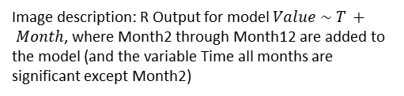
Seasonally Adjusted Model
 | Training Data Scoring
AE | -4.205933e-11
RMSE | 5.949797e+03
 | Testing Data Scoring
AE | -11618.38
RMSE | 2.419322e+04
Lower RMSE for both Training and Testing data (compared to linear trend)
Image description: R Output for model $Value \sim T + Month$, where Month2 through Month12 are added to the model (and the variable Time all months are significant except Month2)

Slide 42
Nonlinear Models
Quadratic Model
Cubic Model
 | Training Data Scoring
AE | -4.22364e-11
RMSE | 5.810336e+03
 | Testing Data Scoring
AE | -22860.43
RMSE | 3.288209e+04
 | Training Data Scoring
AE | -8.589226e-11
RMSE | 5.756309e+03
 | Testing Data Scoring
AE | -46003.48
RMSE | 5.760235e+04

Slide 43
What do we observe?
In the quadratic and cubic model, the RMSE for the training data set is smaller than for the linear model
However, the RMSE for the validation data set is much larger than for the linear model
What does this suggest?
We also observe that average errors are large in magnitude and negative for the validation data set
What’s going on?

Slide 44
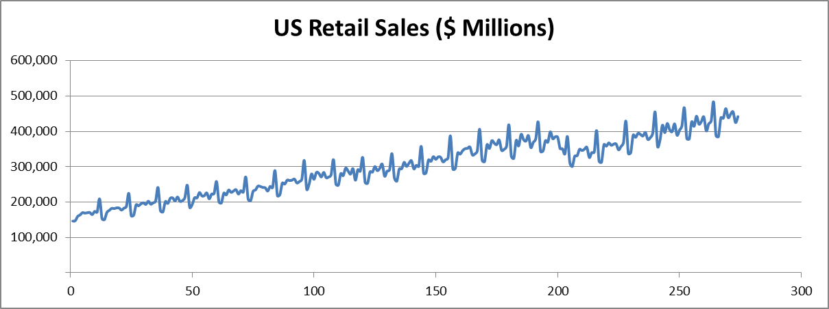
A Look at the Data
What do you observe?
Image description: A seasonal trend chart, showing generally increasing retail sales which demonstrate a cyclical pattern from year to year but also demonstrate a drop-off in sales around month 200 in the data set
Sept 2008 = 201
What happened then?

Slide 45
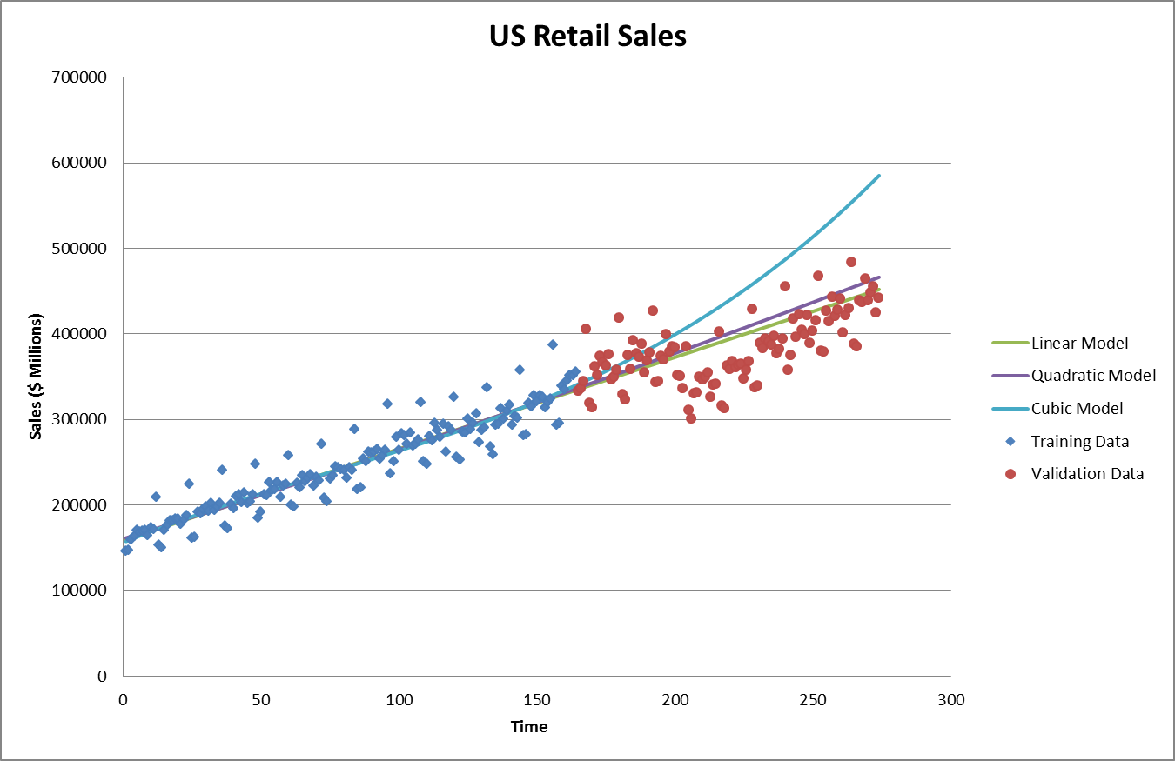
What should we do differently?
Image description: Lines have been added to the scatterplot data of retail sales over time, where three lines are plotted: linear model, which constantly increases; quadratic model, which increases but starts to curve upward for later months in the data set; cubic model, which increases but sharply curves upward for later months
Note: ignoring seasonality

Slide 46
Question to Consider
After fitting a linear regression model, you notice the testing data RMSE is much higher than the training data RMSE. What might you conclude from this?

Slide 47
The ANOVA Table
ANOVA
 | df | Sum of Squares (SS) | Mean Square (MS) | F-Ratio | Prob > F
Model/ Regression
Error
Total
n
SSR
MSR
F
p-value
n-2
SSE
MSE
n-1
SST

Slide 48
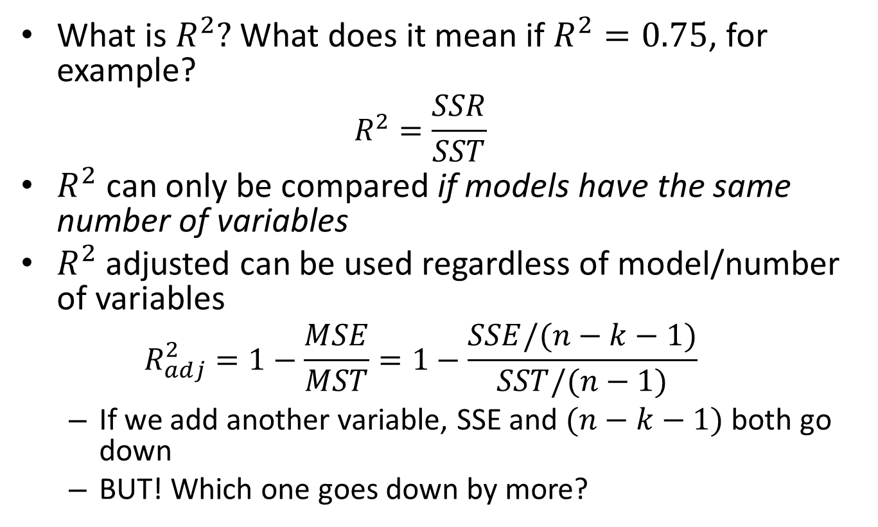

Adjusted $R^{2}$
What is $R^{2}$? What does it mean if $R^{2}=0.75$, for example?
$$R^{2}=\frac{SSR}{SST}$$
$R^{2}$ can only be compared if models have the same number of variables
$R^{2}$adjusted can be used regardless of model/number of variables
$$R_{adj}^{2}=1−\frac{MSE}{MST}=1−\frac{SSE/(n−k−1)}{SST/(n−1)}$$
If we add another variable, SSE and $(n−k−1)$ both go down
BUT! Which one goes down by more?

Slide 49
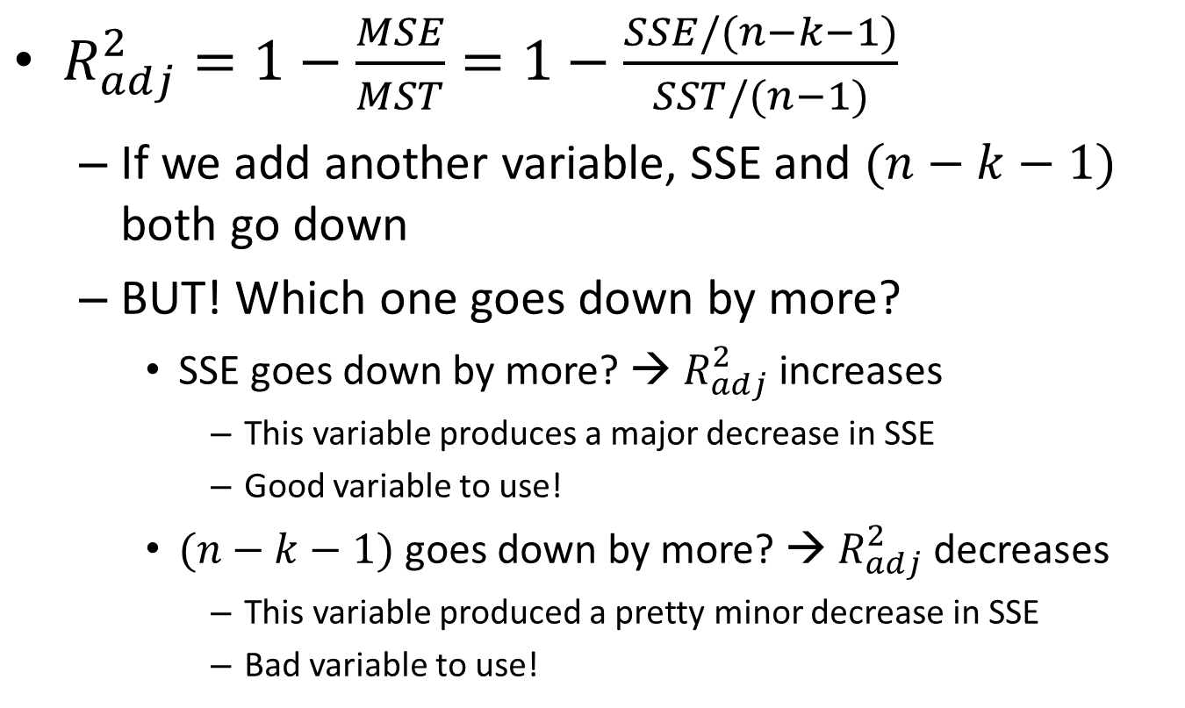

Adjusted $R^{2}$
$R_{adj}^{2}=1−\frac{MSE}{MST}=1−\frac{SSE/(n−k−1)}{SST/(n−1)}$
If we add another variable, SSE and $(n−k−1)$ both go down
BUT! Which one goes down by more?
SSE goes down by more? → $R_{adj}^{2}$ increases
This variable produces a major decrease in SSE
Good variable to use!
$(n−k−1)$ goes down by more? → $R_{adj}^{2}$ decreases
This variable produced a pretty minor decrease in SSE
Bad variable to use!

Slide 50
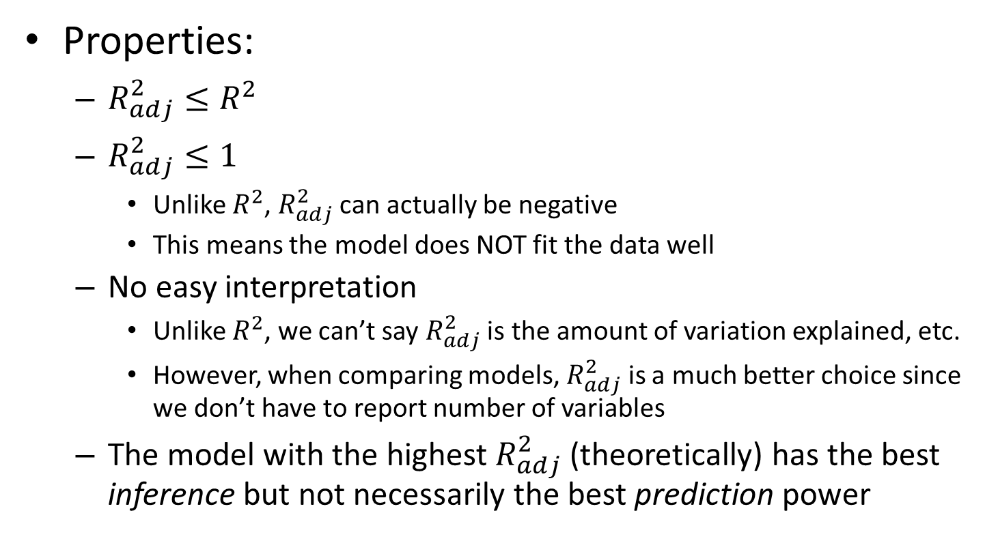

$$R_{adj}^{2}$$
Properties:
$R_{adj}^{2}≤R^{2}$
$R_{adj}^{2}≤1$
Unlike $R^{2}$, $R_{adj}^{2}$ can actually be negative
This means the model does NOT fit the data well
No easy interpretation
Unlike $R^{2}$, we can’t say $R_{adj}^{2}$ is the amount of variation explained, etc.
However, when comparing models, $R_{adj}^{2}$ is a much better choice since we don’t have to report number of variables
The model with the highest $R_{adj}^{2}$ (theoretically) has the best inference but not necessarily the best prediction power

Slide 51
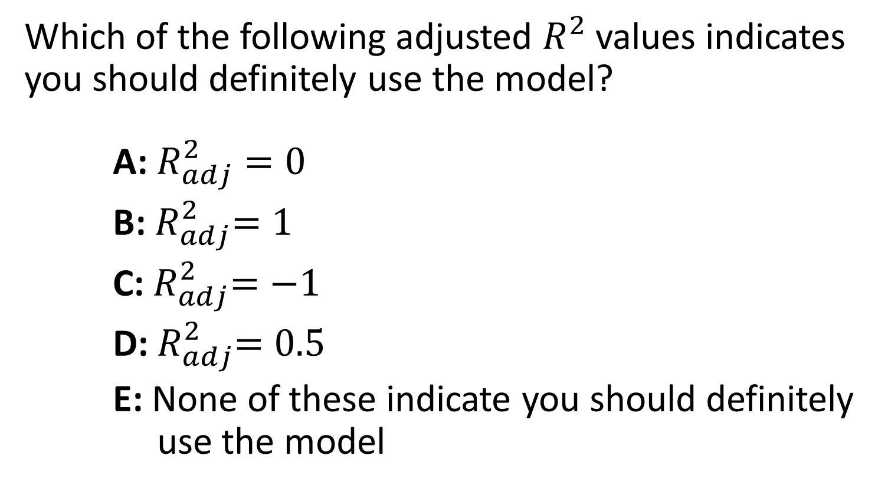
Question to Consider
Which of the following adjusted $R^{2}$ values indicates you should definitely use the model?
A: $R_{adj}^{2}=0$
B:${ R}_{adj}^{2}=1$
C:${ R}_{adj}^{2}=−1$
D:${ R}_{adj}^{2}=0.5$
E: None of these indicate you should definitely use the model

Slide 52
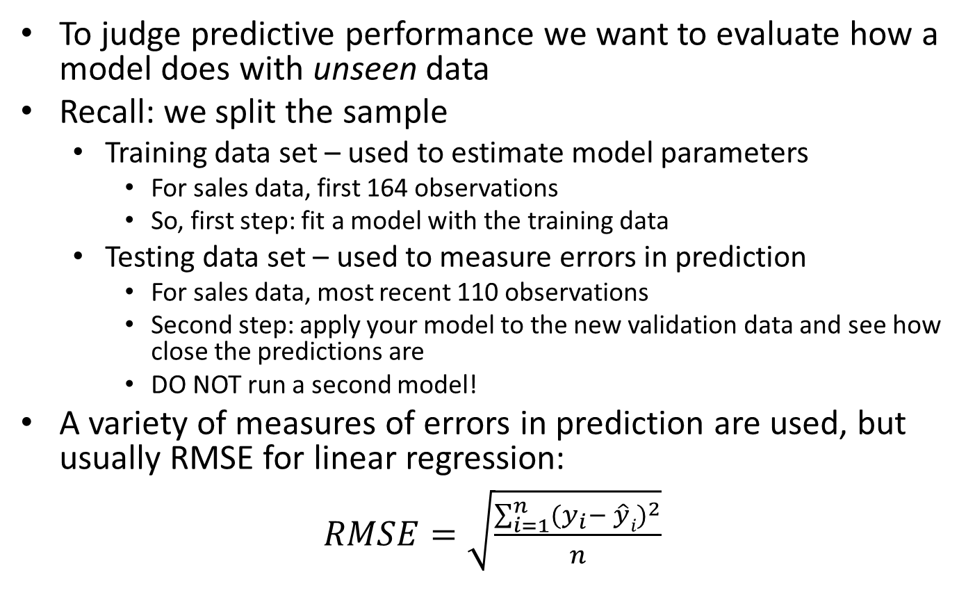
Data Partitioning
To judge predictive performance we want to evaluate how a model does with unseen data
Recall: we split the sample
Training data set – used to estimate model parameters
For sales data, first 164 observations
So, first step: fit a model with the training data
Testing data set – used to measure errors in prediction
For sales data, most recent 110 observations
Second step: apply your model to the new validation data and see how close the predictions are
DO NOT run a second model!
A variety of measures of errors in prediction are used, but usually RMSE for linear regression:
$RMSE=\sqrt{\frac{\sum_{i=1}^{n}{(y_{i}{− \hat{y}i)}^{2}}}{n}}$

Slide 53
So what’s left?
Two major real-world ideas left to incorporate: indicator variables and interaction effects
You notice in your data that women seem to spend more in college tuition than men
Including women vs. men in your regression is done through indicator variables
Categorical variables
You notice in your data that women seem to spend more in college tuition only in liberal arts programs; otherwise they spend amounts comparable to men
You want to see if there’s a relationship between gender and tuition spend, but accounting for type of program
This is a potential interaction effect

Slide 54
Categorical Variables
So far, all the variables we’ve used have been numeric
Age
Income
House size/price
Sales
Advertising
What if we have interesting non-numeric (categorical) variables?
Gender
Ethnicity
Geographic location (city, county, etc.)
Income brackets
Type of industry
Type of investment

Slide 55
Categorical Variables
Imagine we’re interested in predicting a categorical variable (i.e. our Y variable is categorical)
Examples:
Will someone buy a particular product or not?
Will a company make a profit or not?
Will someone click on an ad or not?
This happens a lot, particularly in business problems → “predictive analytics”
We’ll look at some of this next; for now, use categorical variables as predictors
But regression can only take numerical values, so what do we do?

Slide 56
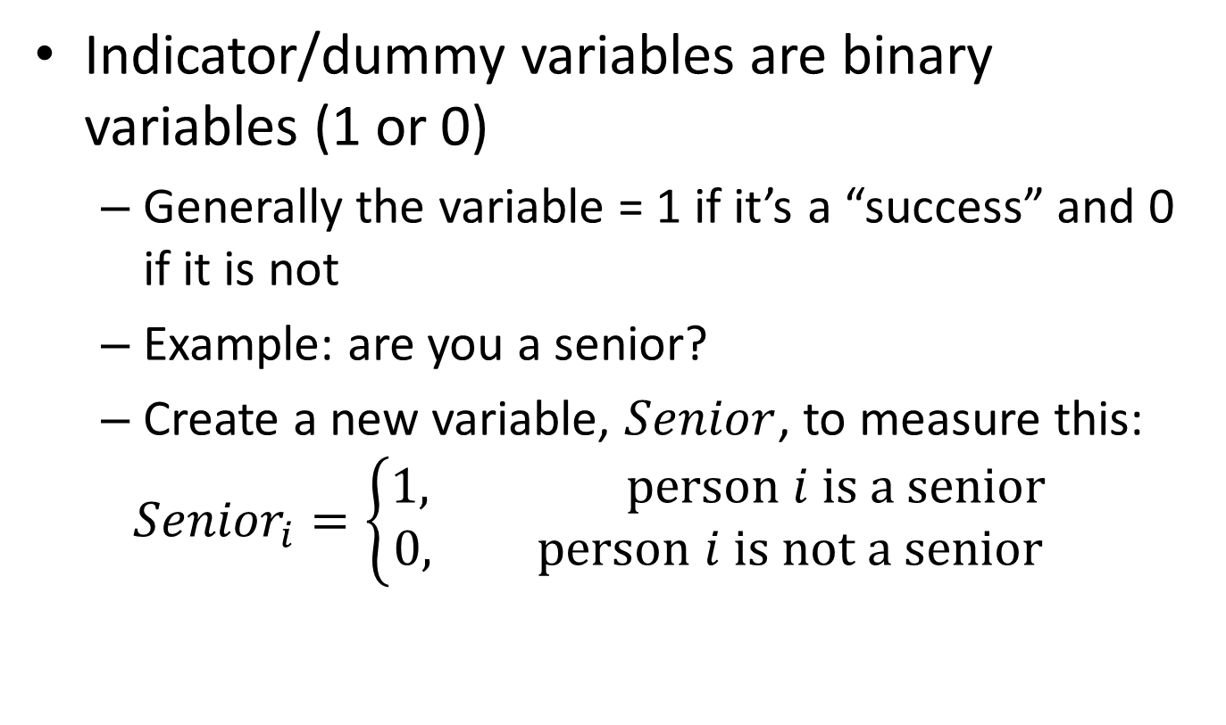
Indicator Variables
Indicator/dummy variables are binary variables (1 or 0)
Generally the variable = 1 if it’s a “success” and 0 if it is not
Example: are you a senior?
Create a new variable, $Senior$, to measure this:
$${Senior}_{i}=\left\{\begin{aligned}1, person i is a senior \\ &0, person i is not a senior\end{aligned}\right.$$

Slide 57
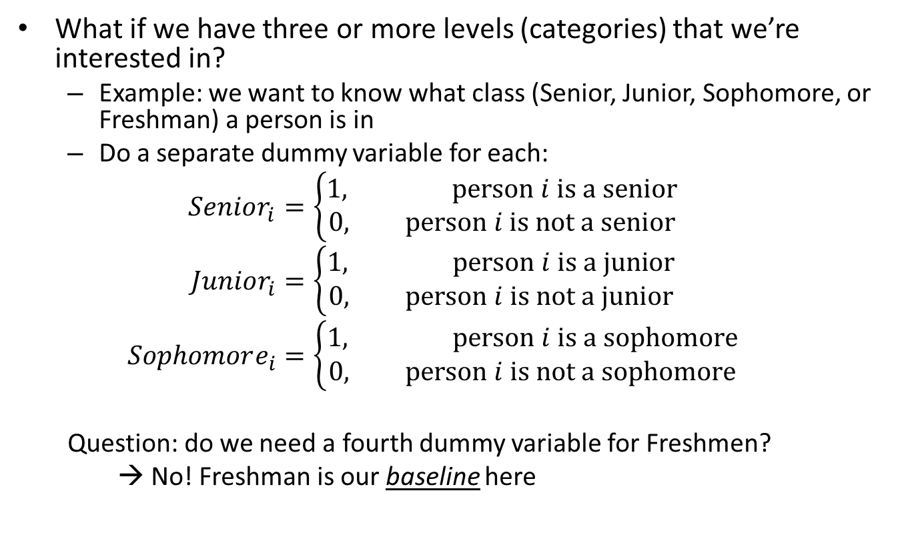
Categorical Variables
What if we have three or more levels (categories) that we’re interested in?
Example: we want to know what class (Senior, Junior, Sophomore, or Freshman) a person is in
Do a separate dummy variable for each:
$$Senior_{i}=\left\{\begin{aligned}1, person i is a senior \\ &0, person i is not a senior\end{aligned}\right.$$
$$Junior_{i}=\left\{\begin{aligned}1, person i is a junior \\ &0, person i is not a junior\end{aligned}\right.$$
$$Sophomore_{i}=\left\{\begin{aligned}1, person i is a sophomore \\ &0, person i is not a sophomore\end{aligned}\right.$$
Question: do we need a fourth dummy variable for Freshmen?
→ No! Freshman is our baseline here

Slide 58
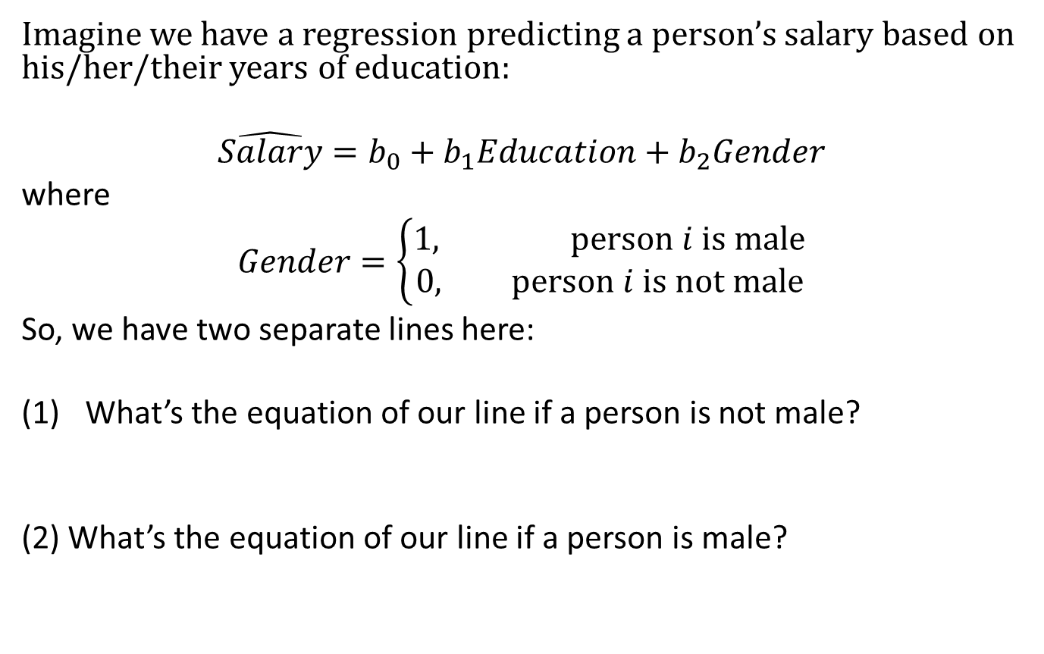
Categorical Variables
Imagine we have a regression predicting a person’s salary based on his/her/their years of education:
$$\hat{Salary}=b_{0}+b_{1}Education+b_{2}Gender$$
where
$$Gender=\left\{\begin{aligned}1, person i is male \\ &0, person i is not male\end{aligned}\right.$$
So, we have two separate lines here:
What’s the equation of our line if a person is not male?
(2) What’s the equation of our line if a person is male?
$$\hat{Salary}=b_{0}+b_{1}Education+b_{2}\left(0\right)=b_{0}+b_{1}Education$$
$$\hat{Salary}=b_{0}+b_{1}Education+b_{2}\left(1\right)=(b_{0}+b_{2})+b_{1}Education$$

Slide 59
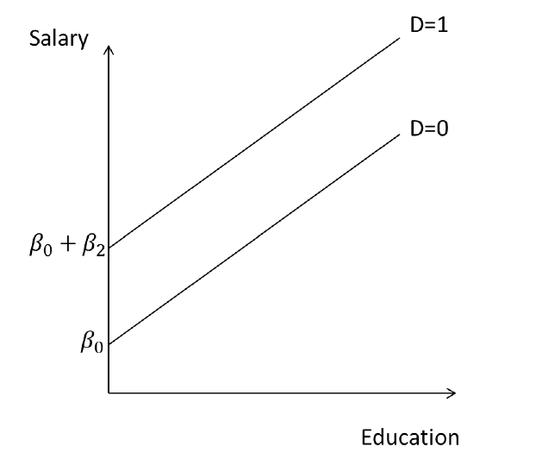
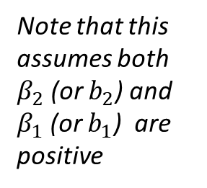
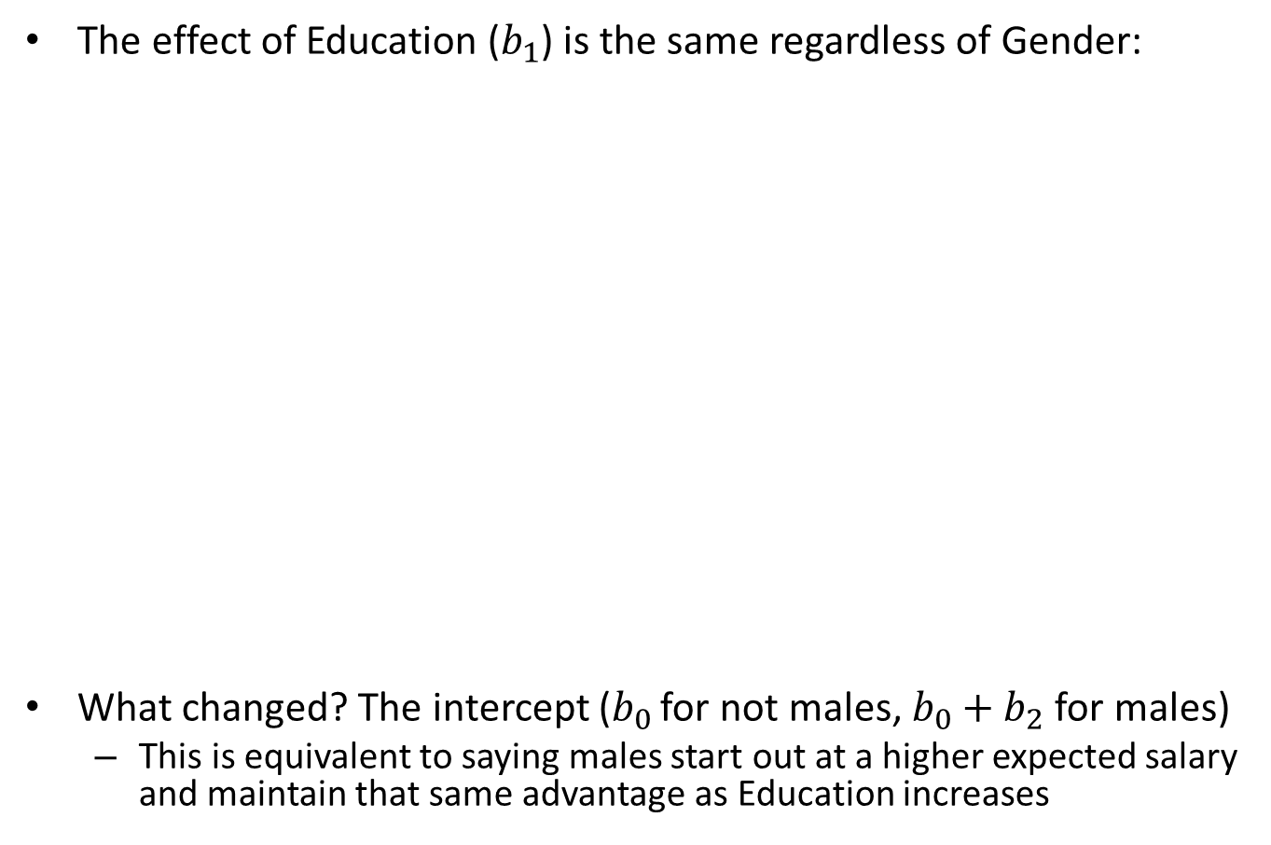
Categorical Variables
The effect of Education ($b_{1}$) is the same regardless of Gender:
What changed? The intercept ($b_{0 }$for not males, $b_{0}+b_{2}$ for males)
This is equivalent to saying males start out at a higher expected salary and maintain that same advantage as Education increases
Gender = 1
Note that this assumes both $β_{2}$ (or $b_{2}$) and $β_{1}$ (or $b_{1}$) are positive
Gender = 0
Image description: A simple x-y chart showing Education on the x-axis and Salary on the y-axis. Two parallel lines with positive slope start from two different intercepts, where the male line (Gender = 1) starts at a higher x-intercept point.

Slide 60
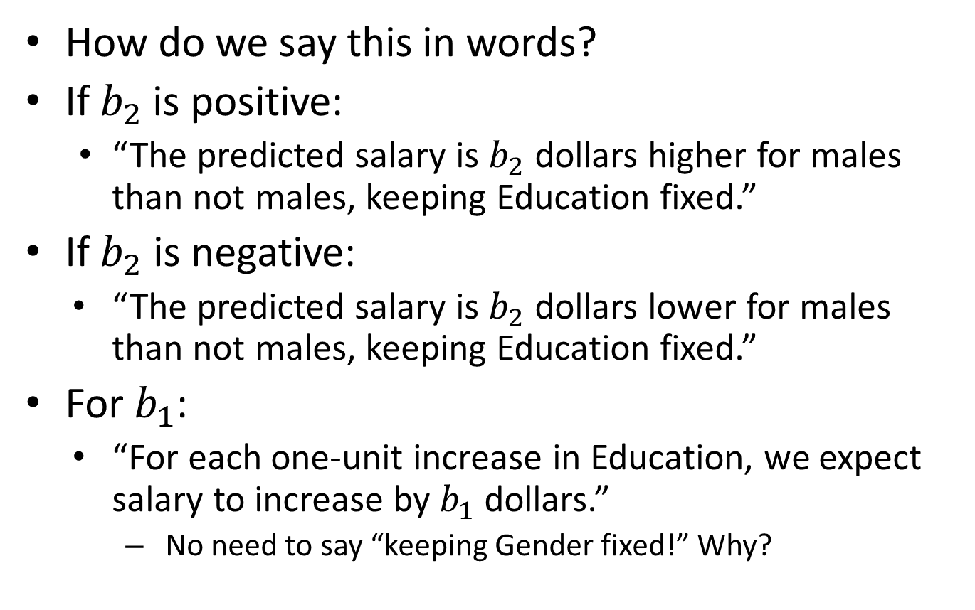
Categorical Variables
How do we say this in words?
If $b_{2}$is positive:
“The predicted salary is $b_{2}$ dollars higher for males than not males, keeping Education fixed.”
If $b_{2}$ is negative:
“The predicted salary is $b_{2}$ dollars lower for males than not males, keeping Education fixed.”
For $b_{1}$:
“For each one-unit increase in Education, we expect salary to increase by $b_{1}$ dollars.”
No need to say “keeping Gender fixed!” Why?
Notes:
This is the effect of education (the slope), which is the same for either gender

Slide 61
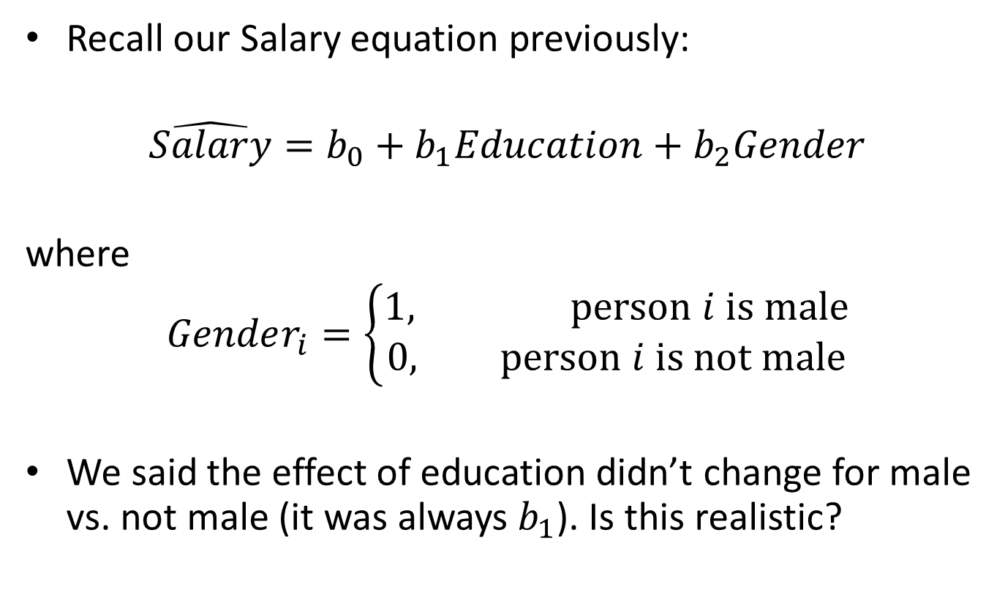
Interaction Variables
Recall our Salary equation previously:
$$\hat{Salary}=b_{0}+b_{1}Education+b_{2}Gender$$
where
$$Gender_{i}=\left\{\begin{aligned}1, person i is male \\ &0, person i is not male\end{aligned}\right.$$
We said the effect of education didn’t change for male vs. not male (it was always $b_{1}$). Is this realistic?

Slide 62
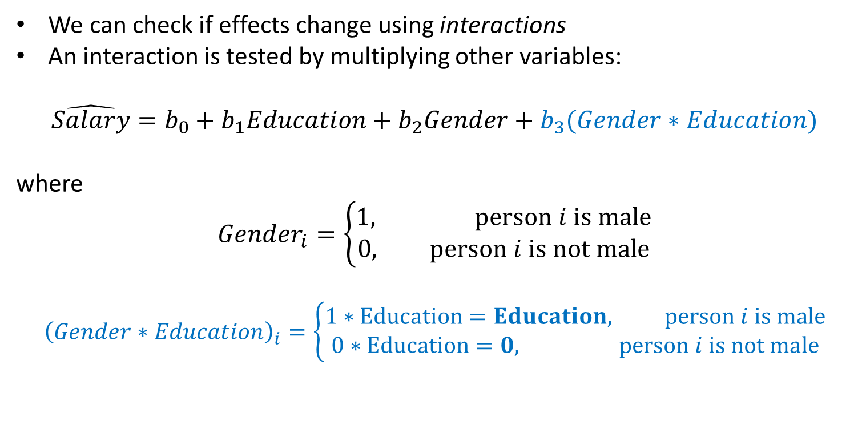
Interaction Variables
We can check if effects change using interactions
An interaction is tested by multiplying other variables:
$$\hat{Salary}=b_{0}+b_{1}Education+b_{2}Gender+b_{3}(Gender∗Education)$$
where
$$Gender_{i}=\left\{\begin{aligned}1, person i is male \\ &0, person i is not male\end{aligned}\right.$$
$${\left(Gender∗Education\right)}_{i}=\left\{\begin{aligned}1∗Education=Education, person i is male \\ &0∗Education=0, person i is not male\end{aligned}\right.$$

Slide 63
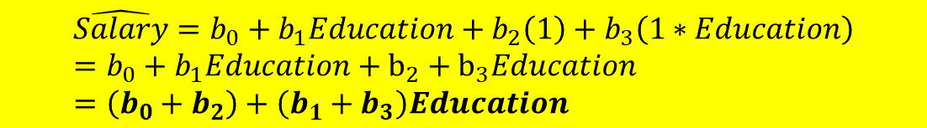
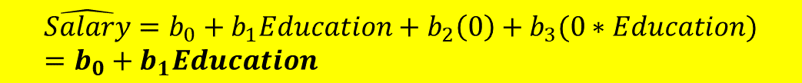
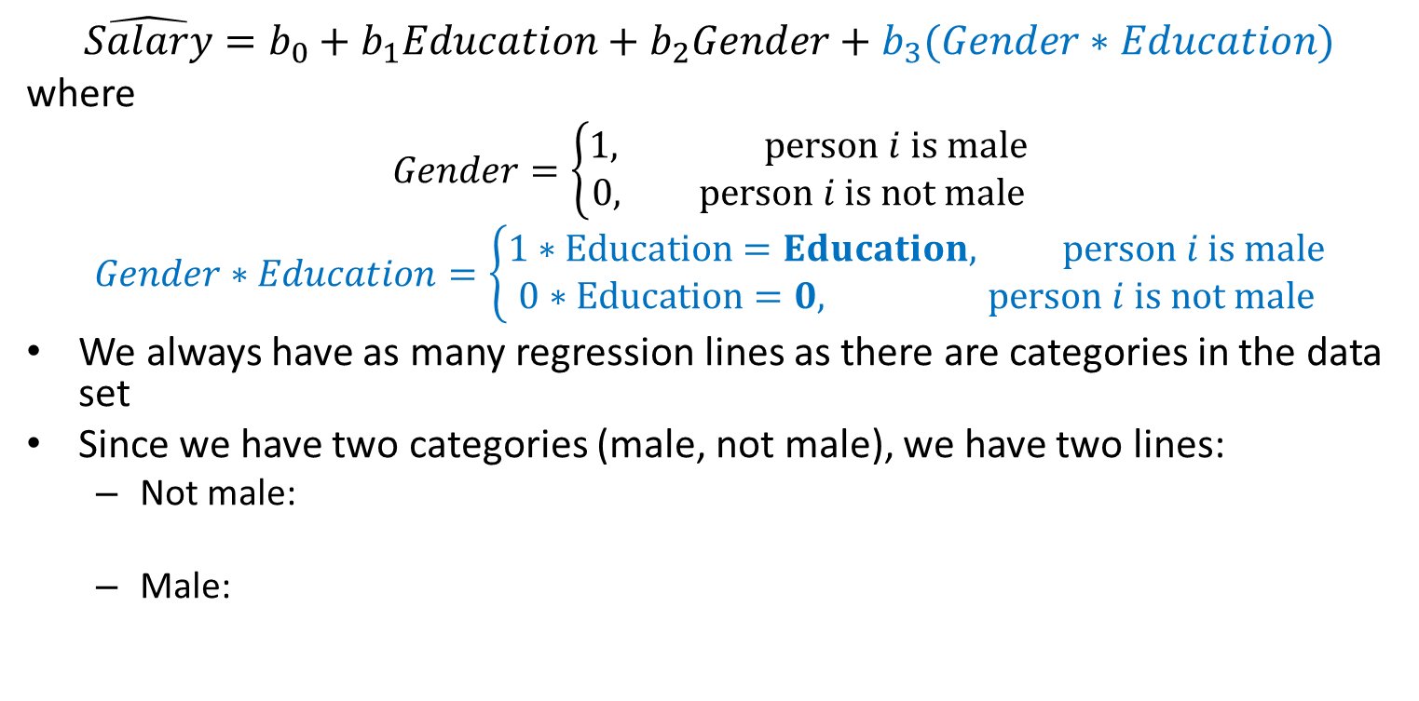
Interaction Variables
$$\hat{Salary}=b_{0}+b_{1}Education+b_{2}Gender+b_{3}(Gender∗Education)$$
where
$$Gender=\left\{\begin{aligned}1, person i is male \\ &0, person i is not male\end{aligned}\right.$$
$$Gender∗Education=\left\{\begin{aligned}1∗Education=Education, person i is male \\ &0∗Education=0, person i is not male\end{aligned}\right.$$
We always have as many regression lines as there are categories in the data set
Since we have two categories (male, not male), we have two lines:
Not male:
Male:
$$\hat{Salary}=b_{0}+b_{1}Education+b_{2}\left(0\right)+b_{3}(0∗Education)=b_{0}+b_{1}Education$$
$$\hat{Salary}=b_{0}+b_{1}Education+b_{2}\left(1\right)+b_{3}\left(1∗Education\right)=b_{0}+b_{1}Education+b_{2}+b_{3}Education=\left(b_{0}+b_{2}\right)+\left(b_{1}+b_{3}\right)Education$$

Slide 64

Interaction Variables
So, we have two lines again:
$$\hat{Salary_{not male}}=b_{0}+b_{1}Education$$
$$\hat{Salary_{male}}=(b_{0}+b_{2})+(b_{1}+b_{3})Education$$
Indicator/dummy variable: just the intercept changed
For not males: $b_{0}$
For males: $b_{0}+b_{2}$
Interaction: both intercept and slope have changed
For not males: $b_{1}$
For males: $b_{1}+b_{3}$
This means both the starting point (intercept) AND effect (slope) for expected salary are different for males versus not males
The slope now has an extra interpretation: for every one-year increase in education, expected salary increases by $b_{1}$ if a person is not male and $b_{1}+b_{3}$ if a person is male

Slide 65

Interaction Variables: Example
You want to predict the cost of an open heart surgery for cardiac patients. One big issue (in the U.S., at least!) is whether or not a person has insurance. You create a dummy variable for that:
$$Insured_{i}=\left\{\begin{aligned}1, person i is insured \\ &0, person i is not insured\end{aligned}\right.$$
Other variables we want to put in the model:
Income: a person’s total annual income
Length of procedure: how many minutes is the surgery expected to last (measures how complicated the procedure is)
Age of the patient: how old is the patient (in years)
First question: do we need to worry about interactions?
Notes:
Yes! There are very likely interactions, because a lot of these variables are related (and likely also affect the relationship with cost)

Slide 66

Interaction Variables: Example
Let’s say we run the model with Insured*Income as our interaction variable (and cost in thousands):
$$\hat{Cost}=40.74+0.00122Income+0.51Length−0.54Age+26.89Insured−0.00045(Insured∗Income)$$
Interpret the slope for Income:
“For every additional dollar in annual income a person makes, we expect their cost of open heart surgery to increase by $1.22 if they are not insured and $1.22-$0.45 = $0.77 if they are insured.”
This doesn’t tell us if the change is significant, however
Check p-value! If the interaction is significant, the change is significant

Slide 67
Interaction Variables: Wrap Up
One last note on interactions:
If you include an interaction, you must include all variables that make up that interaction as well
Example: you can’t use Age*Income without including both Age and Income
This works for higher-order interactions as well
If you want to include a term for Age*Income*Education, you must include:
Age
Income
Education
Age*Income
Age*Education
Education*Income

Slide 68
Conclusion
Linear Regression can be very useful for prediction
However, there are some important things to note:
We are always using sample data to make inferences about a population
Performance should always be measured on unseen data
Partitioning into training and validation data sets
Performance criteria can change evaluation
e.g., RMSE and average error
There are common issues in choosing among different models: interaction, indicator, time series, nested models
Bottom line: use common sense! Interpretability vs. Prediction Accuracy

Slide 69
Question to Consider
You run a regression with a geographic variable that has five possible options: North, South, East, West, and Central. How many dummy/indicator variables do you need to add in your model to capture this geographic variable?

Slide 70
Question to Consider
You are running a linear model to predict the rate of return on a stock. You are using volatility of the stock and historical pricing data of the stock to predict return. You think there could be a relationship between volatility and price that affects return. Should you include an interaction variable in your model?

